Slide 1
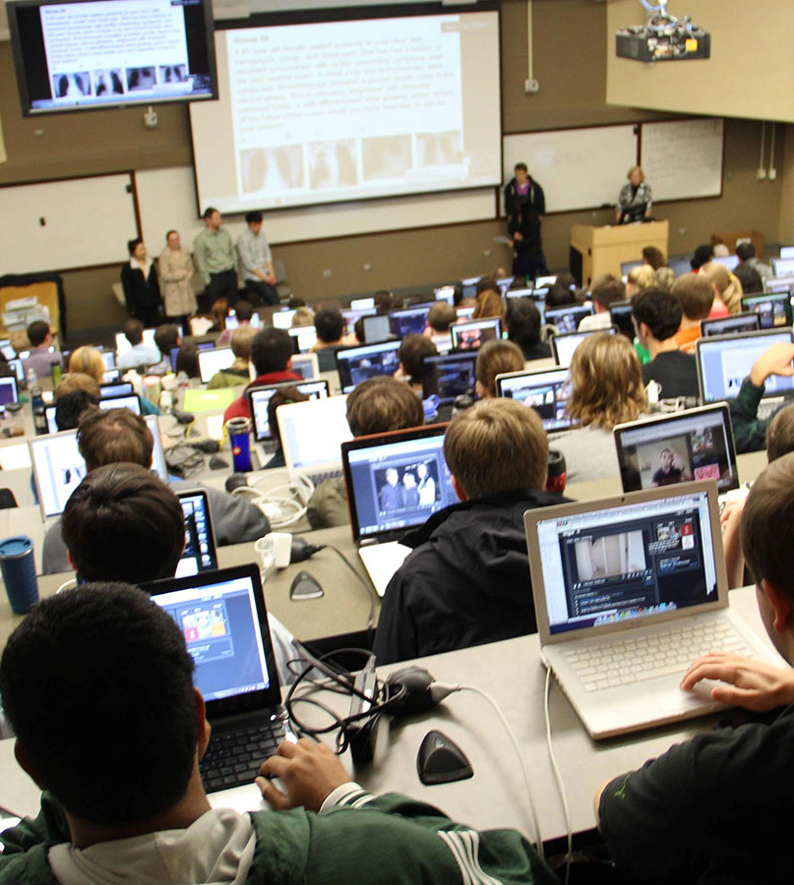


Tech-Aided Education
Matthew Krause and Connor Dunleavy

Slide 2
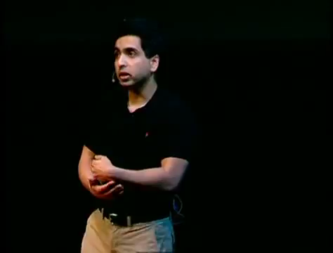

Slide 3

The Promises of Tech-Aided Education
The tech-aided classroom will provide the motivation and prevent the student from getting bored (Kearsley, 64).
The tech-aided classroom will allow individuals with learning disabilities to get the individualized education they require (Kearsley, 72).
The effectiveness of the education is dependent upon the instructor’s skill of teaching with tech (Kearsley, 85).

Slide 4
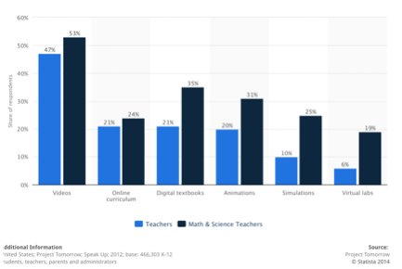
The Realities of Tech-Aided Education Today
Tech in education is inconsistent between teachers at the same institution (Selwyn, 25).
Many teachers are inept at using computers to their full potential.
The only constant form of tech use in school are word processors, videos, powerpoint presentations, and the use of search engines (Project Tomorrow).

Slide 5

The Direction of Tech-Aided Education
We are currently seeing a rise in the flipped classroom, where content is consumed at home, and then discussed or practiced in class (Khan).
This is the way many classes (languages in specific) are taught at UNC.
Gamification of instruction with the use of video game.

Slide 6
The Pros of Digital Flipped Classroom Model
It allows for a more equalized lecture, in which the student can go through the content as fast or slow as they need (Seale, 25).
Offers multimedia and interactivity (Belskie).
Teachers can spot gaps in knowledge quickly through technologies like Khan Academy (Thompson, 182).

Slide 7
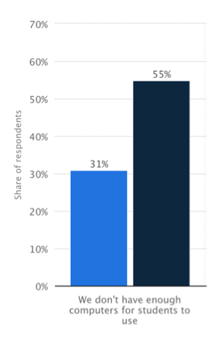

The Cons of the Digital Flipped Classroom Model
During lecture/home study, student cannot ask for help on a specific example and receive immediate feedback.
It assumes access to high-speed internet is available, with very few legislators who are willing to subsidize the costs of providing access to all (Selwyn, 56).
The need for more, faster computers are increasing higher than the rate that they can be provided (Project Tomorrow).

Slide 8
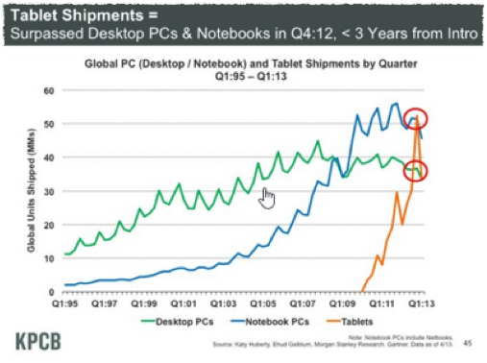
Providing Enough Computers/Devices with Internet Access
Growth of tablets will make flipped classrooms more feasible.
Cheap
Mobile
Interactive

Slide 9
Are Video Games the Future of Education?
No.
However, certain aspects of video games are likely to be seen in educational software:
Rewards
Interactivity
Framework
Design elements -- have students design their own “game” with educational elements.

Slide 10
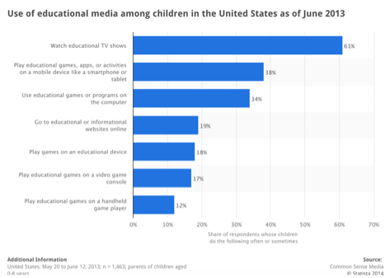
Gamification
The use of video games as an educational tool is no new idea, and is something that is very common to be seen today.
Video games not only offer interactivity but rewards (Belskie).
Video games offer a certain framework (i.e. simulation), unlike most educational software.
Many video games offer some sort of customization/designer abilities.

Slide 11
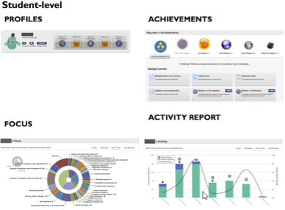
Evaluating the Quality of Digital Content
Khan Academy - tracks progress for teachers, pattern recognition, even more features can be easily added
Pair this with in class activities and quizzes

Slide 12
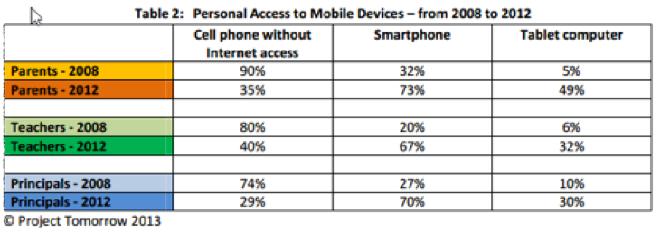
Teachers Are Not Trained on How to Best Use Technology in Class
Only way this will change is by increasing the access to technology in the classroom setting

Slide 13
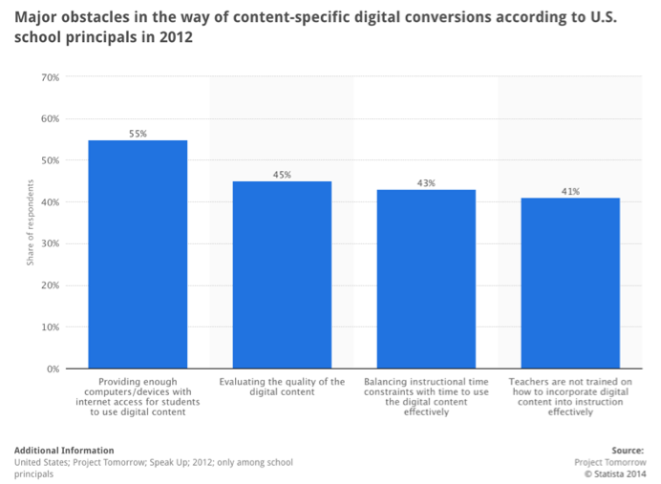
Obstacles to Classroom Conversion

Slide 14
Conclusion
Computer integration to the classroom has been happening for the past few decades and has no signs of decreasing.
There are obstacles to be overcome for tech to be integrated in more classrooms at all levels of education.
Tech-aided in education is going in a different direction than it has in the past with the flipped classroom and gamification, overall increasing it’s effectiveness.

Slide 15
Sources
Belskie, Matthew L. “Analysis of interactive design elements in a practical application of gamification to learning: Khan academy.” Department of Information Science. University of North Carolina. March 2012. Web. 11 Oct. 2014.
Kahn, Salman. “Turning the Classroom Upside Down” The Wall Street Journal. 9 Apr. 2011. Web. 10 Oct. 2014.
Kearsley, Greg. “Online Education: Learning and Teaching in Cyberspace.” Thomson Learning. Stamford, CT, USA. 2000. Text.
Seale, Jane K. “E-Learning and Disability in Higher Education.” Routledge. Abingdon, Oxford, England. 2006. Text.
Selwyn, Neil. “Schools and Schooling in the Digital Age.” Routledge. Abingdon, Oxford, England. 2011. Text.

